Slide 1

Medicare System
Final Presentation by TEAM 96
Bhavin Dave
Parthiv Shah
Saurabh Satra

Slide 2
Problem Statement
There is a lack of awareness related to Medicare related Awareness camps in rural part of the developing countries. Due to which millions leave in sub human conditions and lack of amenities.
“Lack of proper distribution channel” is a huge problem faces by millions living in rural areas of developing countries. Due to which proper medication is not available to the citizens of the countries.
Citizens in developing countries are not aware of nearby medical related organizations. Due to which many have to suffer.

Slide 3
Solution to the problem
Our solution will empower, the users to select any Pharmacy/Lab/Doctor in their city.
Patients can view the details of the upcoming awareness camps and they can even register for that event.
Patients can be able to view the updated list of the Pharmacy/Lab/Doctor in their city.
Without leaving their home, patient can book the product(medicines, test, appointments) using our app.

Slide 4
Approach
Lab, event camps, doctors will share the same platform .So the patient can view the products without leaving their homes.
Patients can directly book their products from their respective organizations.

Slide 5
Use Cases
All Users:
Login
View/Modify Profile
Change Password
Patient:
Registration
Select Doctors/Labs/Pharmacies/Social Events in the selected city
Add the Products/Events
View/Modify/Clear Shopping Cart.
Place order and view Order History

Slide 6
Use Cases
Pharmacy Manager:
Add/Modify/Remove Products
Confirms/Cancels Order.
Chooses the Delivery Company to deliver the Order
Delivery Manager:
Add new Delivery Man
Overview Ongoing Orders.
Cancel Order.
Delivery Man:
Initialize Delivery once picked up from pharmacy
Update Status of the order.

Slide 7
Use Cases
Doctor:
Confirm or Cancel Appointments of Patients
Confirms his/ her availability for Social Events
Lab Assistant:
Schedules or Cancels tests of Patients
Confirms his/her availability for Social Events
Event Manager:
Confirms or Cancels the Event of Patient
Invites Doctors/Lab Assistants for Social Events

Slide 8
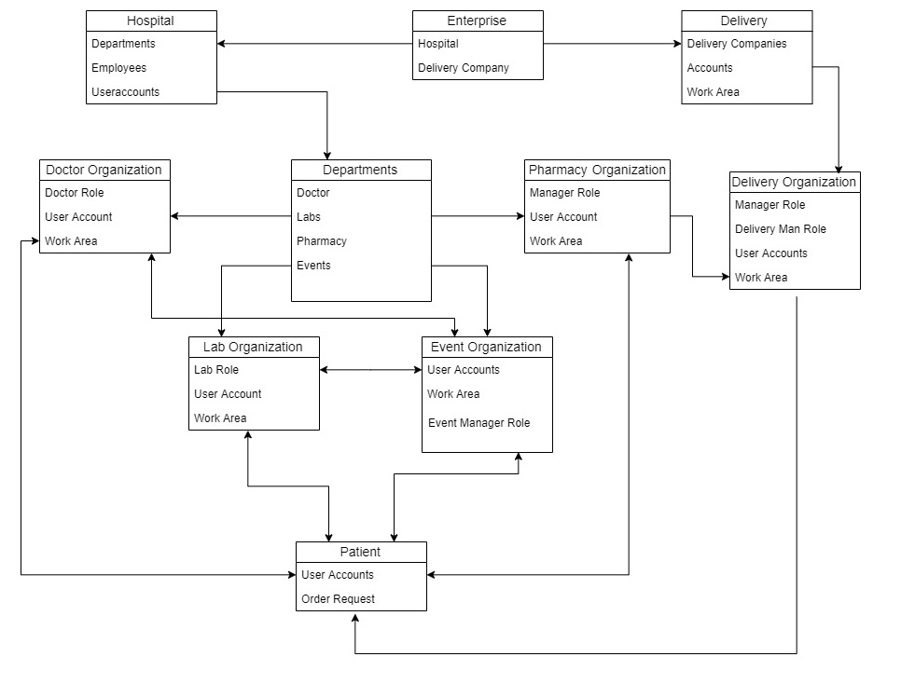
Object Model

Slide 9
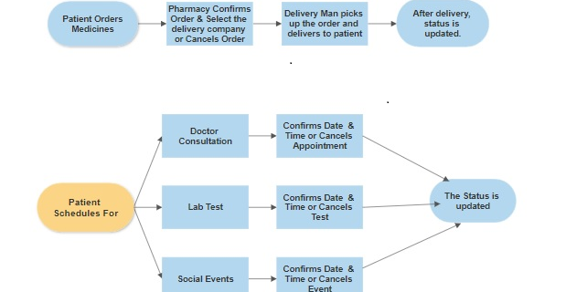
WORK FLOW

Slide 10
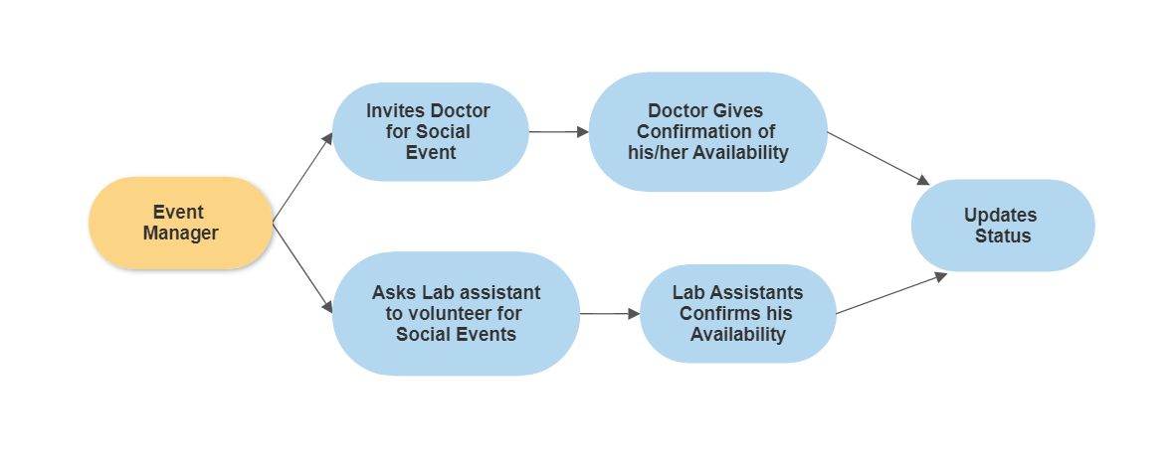

Slide 11

Login Page for All Users.

Slide 12
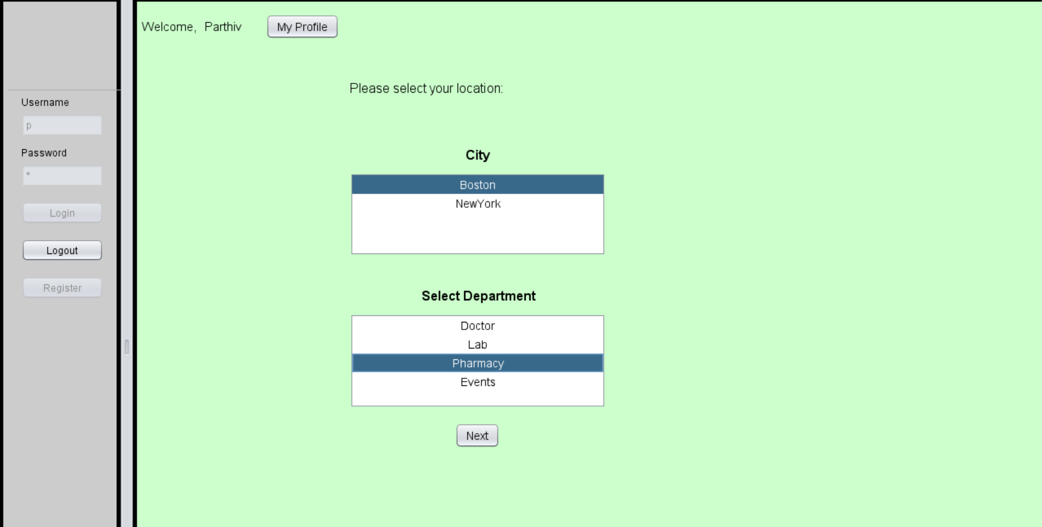
Patient Main Page

Slide 13
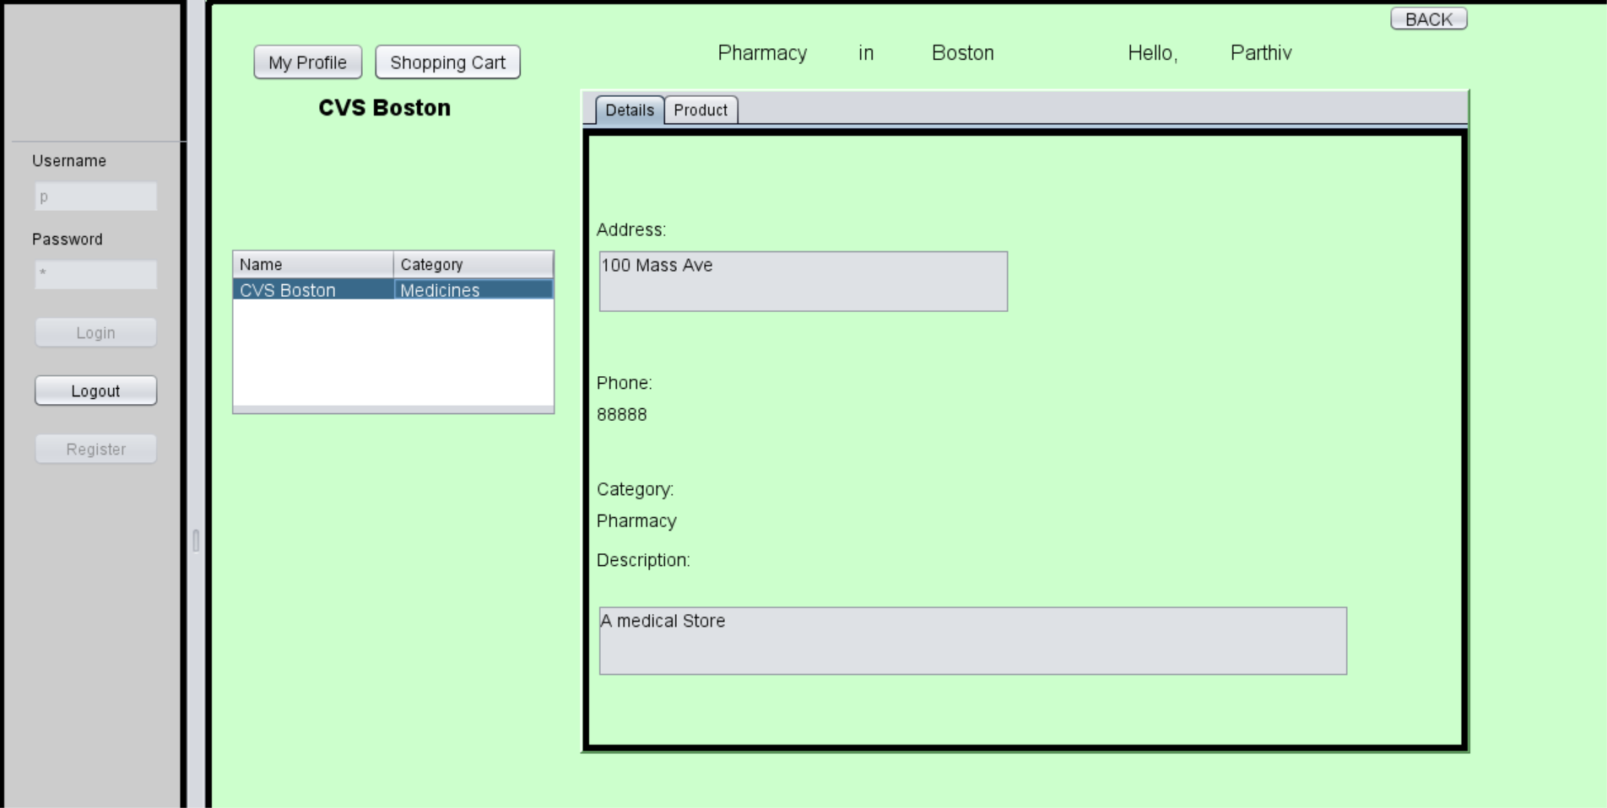
Patient Order Page

Slide 14
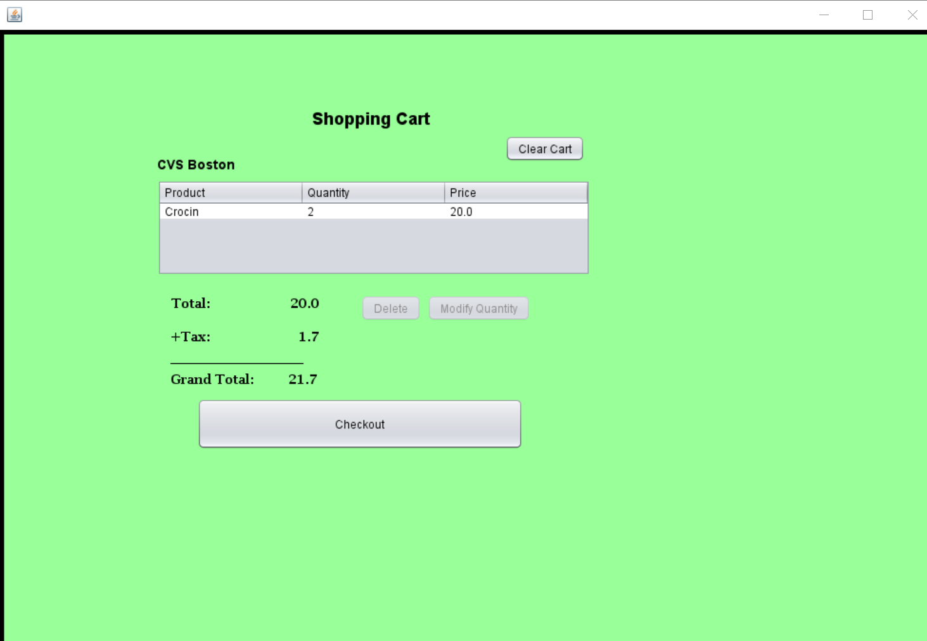
Patient Shopping cart

Slide 15
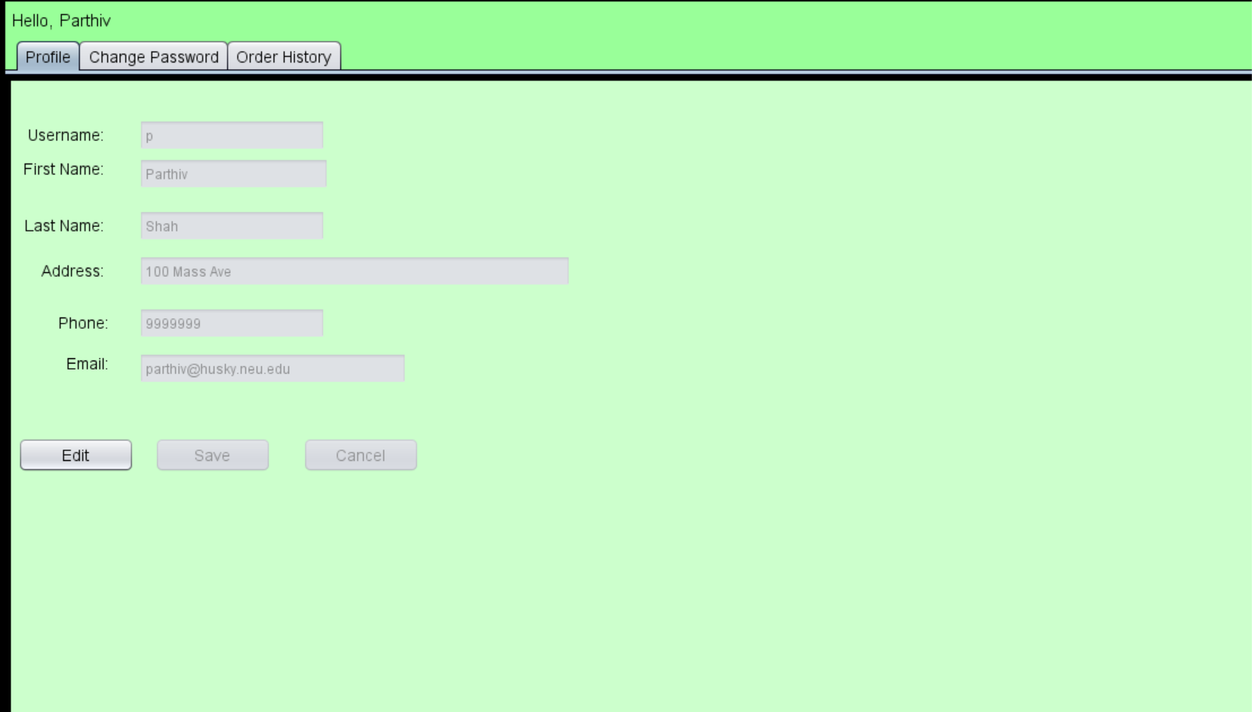
Patient Profile details

Slide 16
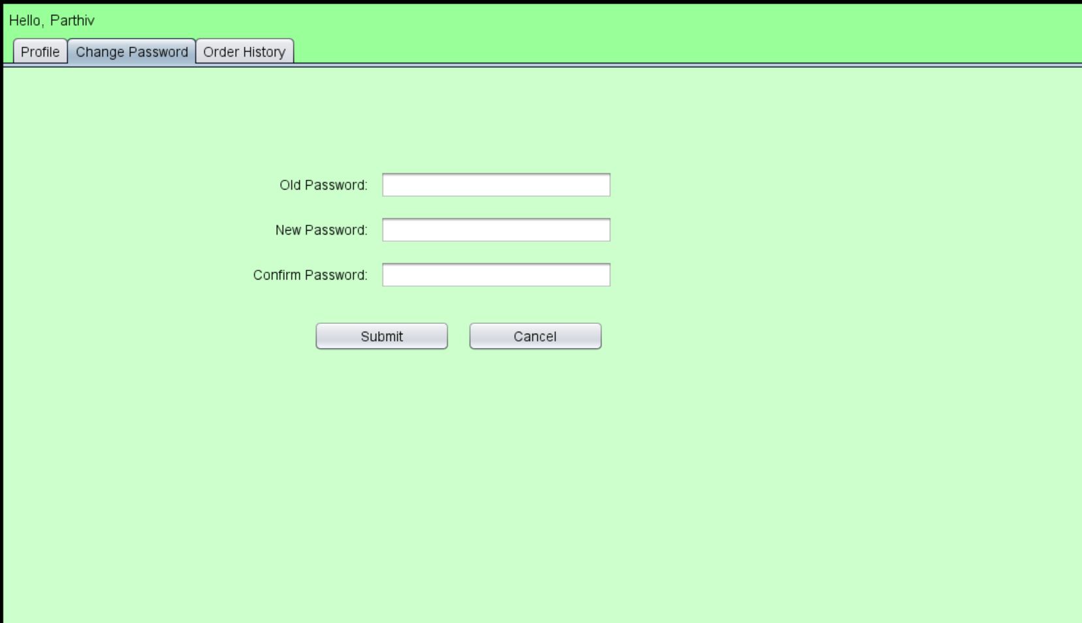
Patient change password

Slide 17
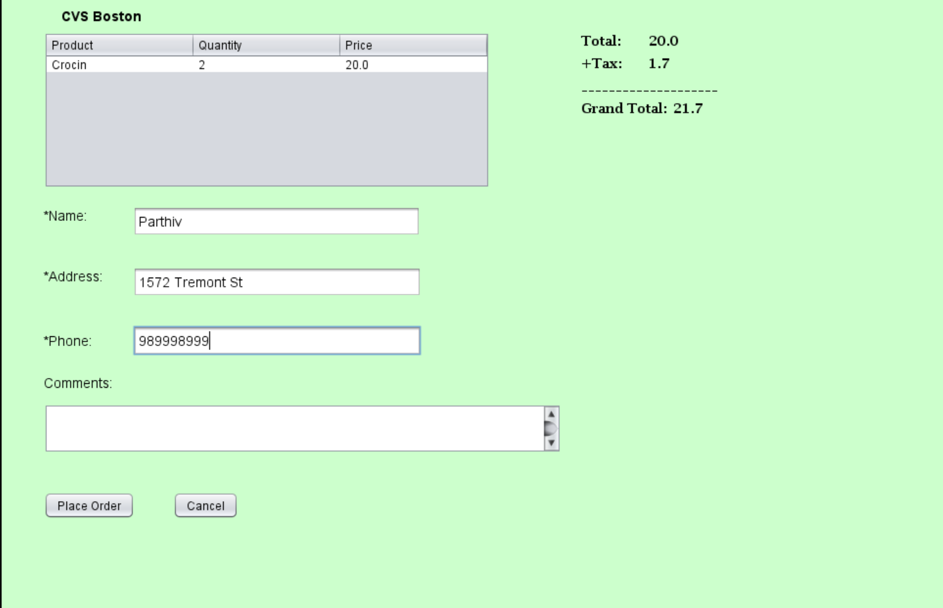
Patient order details

Slide 18
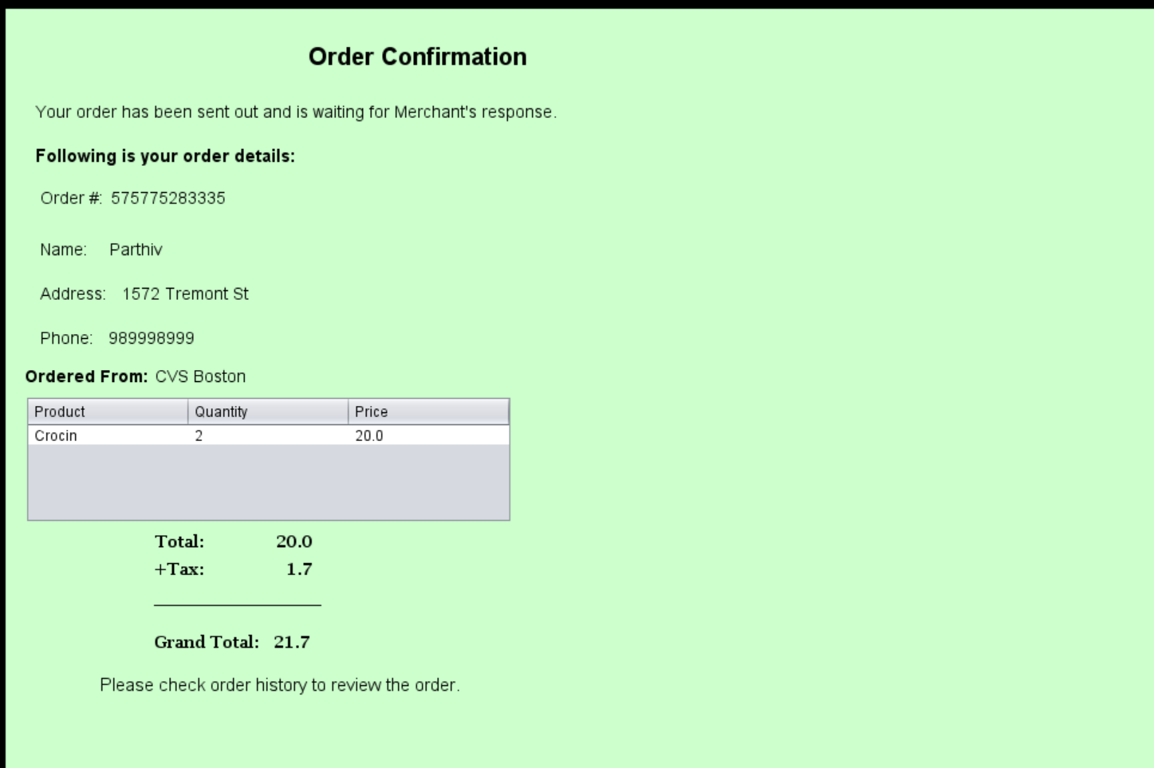
Patient Order Confirmation

Slide 19
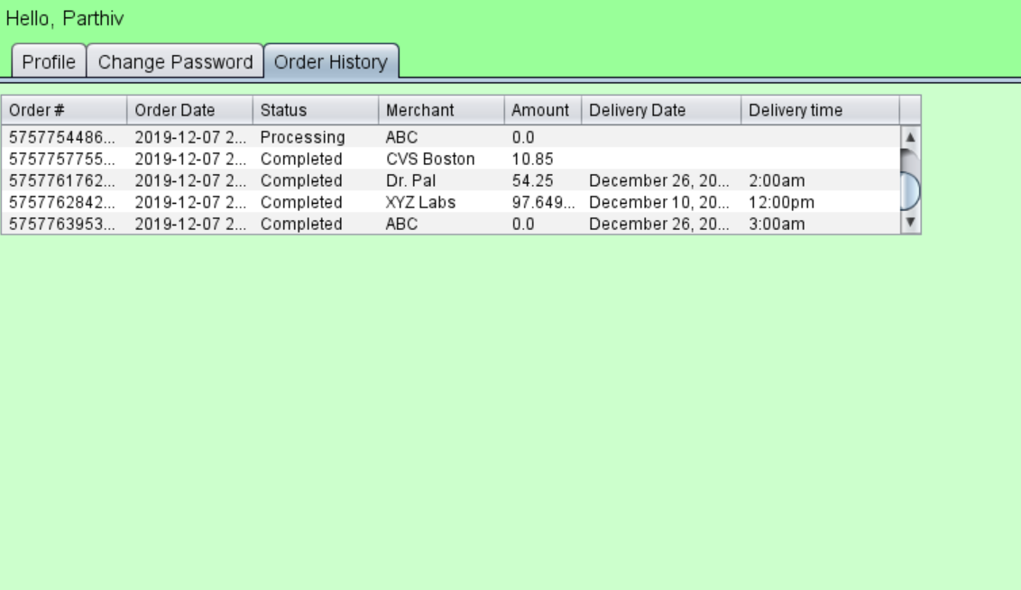
Patient Order History

Slide 20
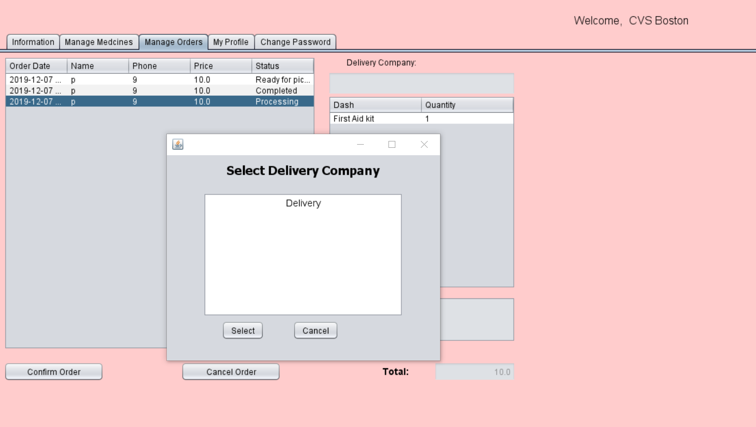
Pharmacy Mange orders

Slide 21
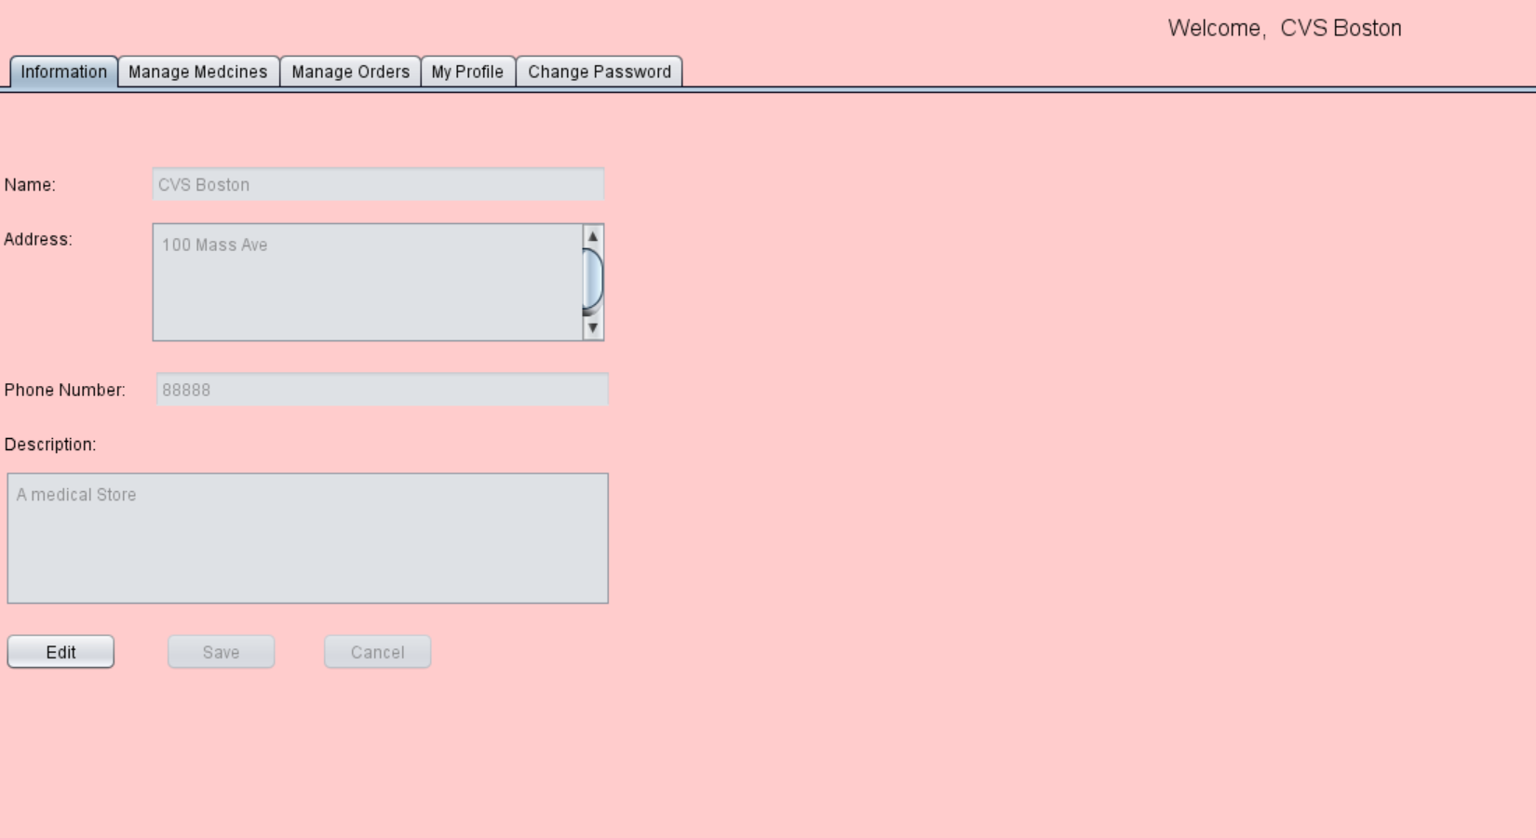
Pharmacy Info Page

Slide 22
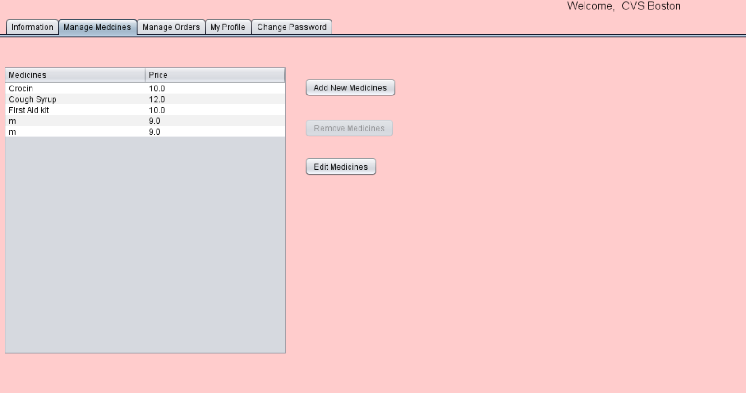
Pharmacy Manage medicines Page

Slide 23
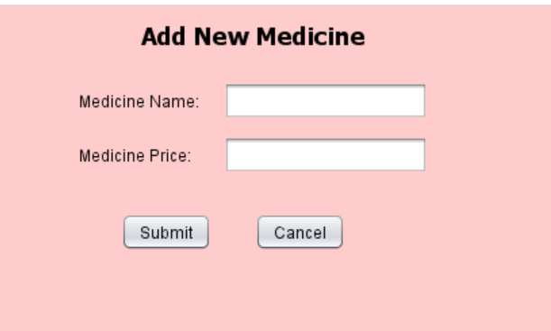
Pharmacy add medicine page

Slide 24
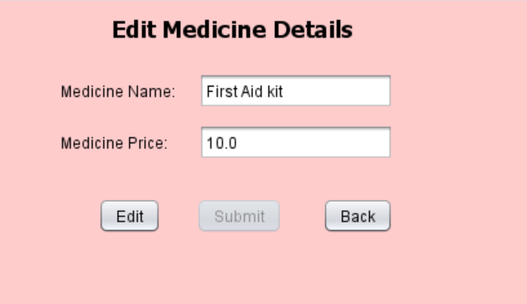
Pharmacy edit medicine

Slide 25
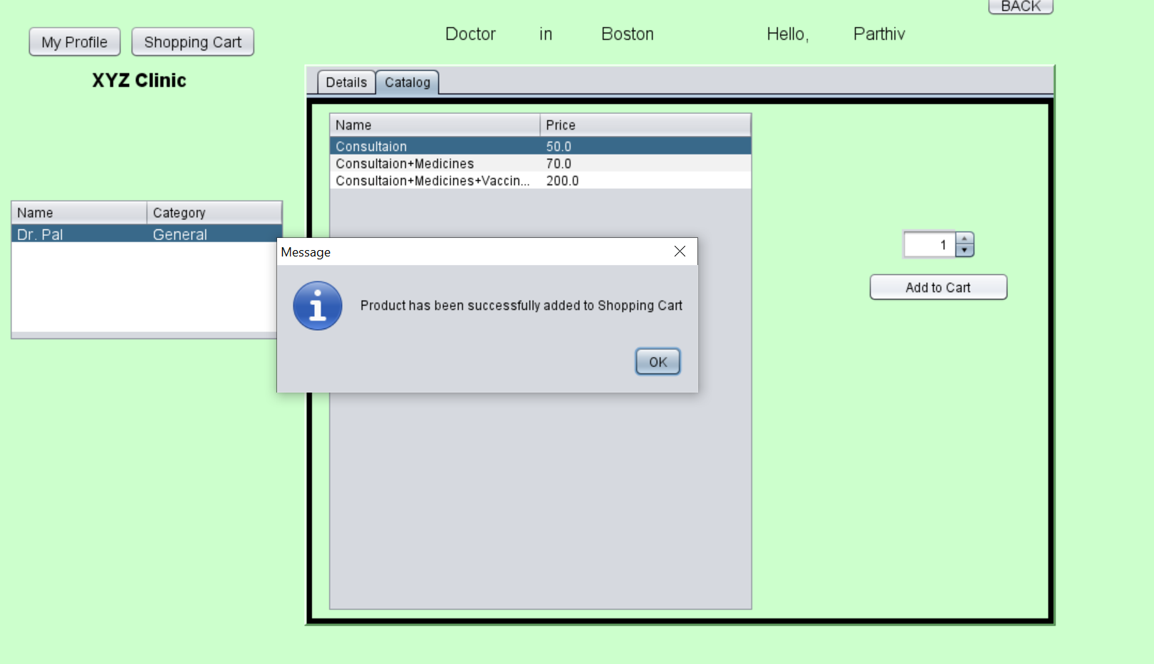
Patient doctor catalog page

Slide 26
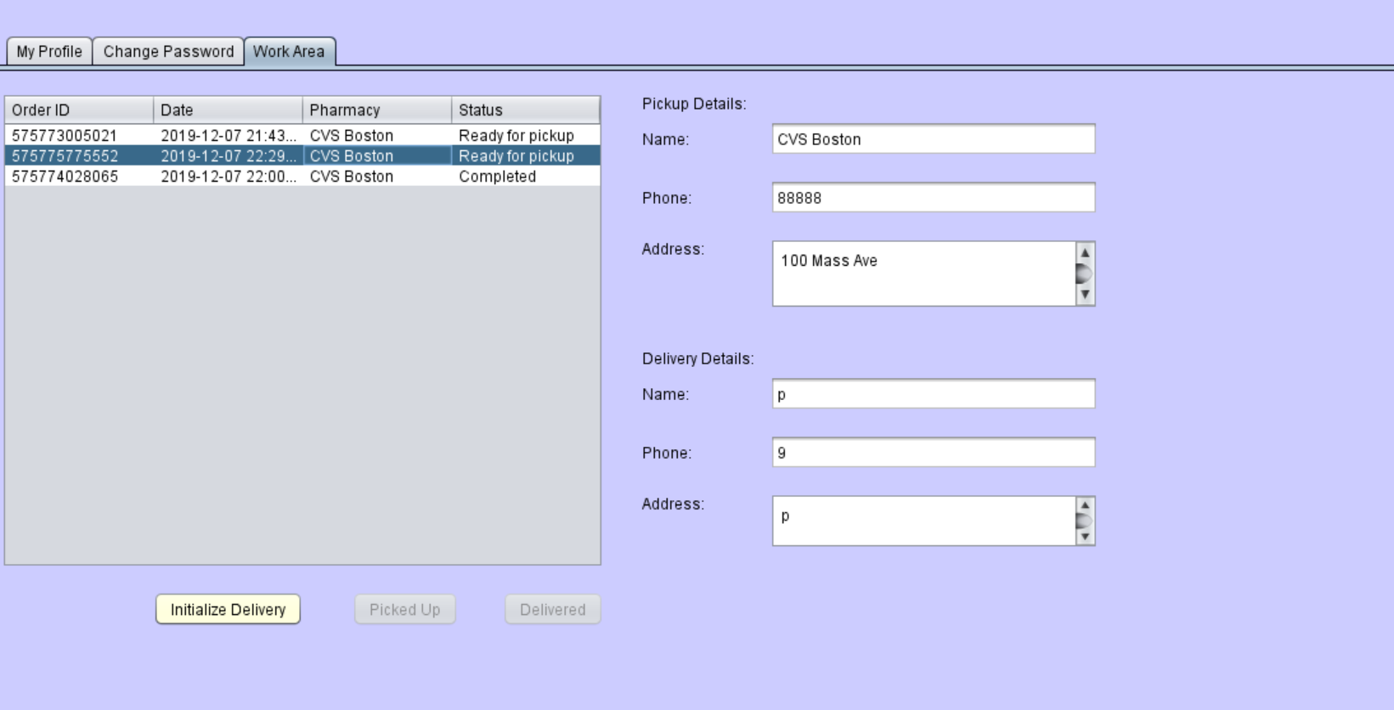
Delivery work area—Initiate delivery

Slide 27
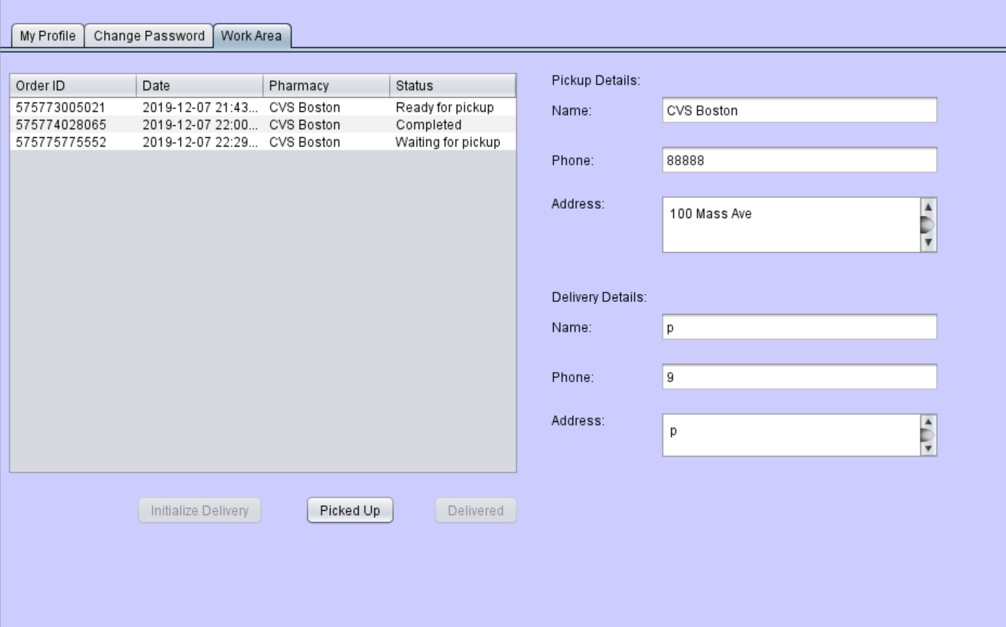
Delivery work area—ready for pickup

Slide 28
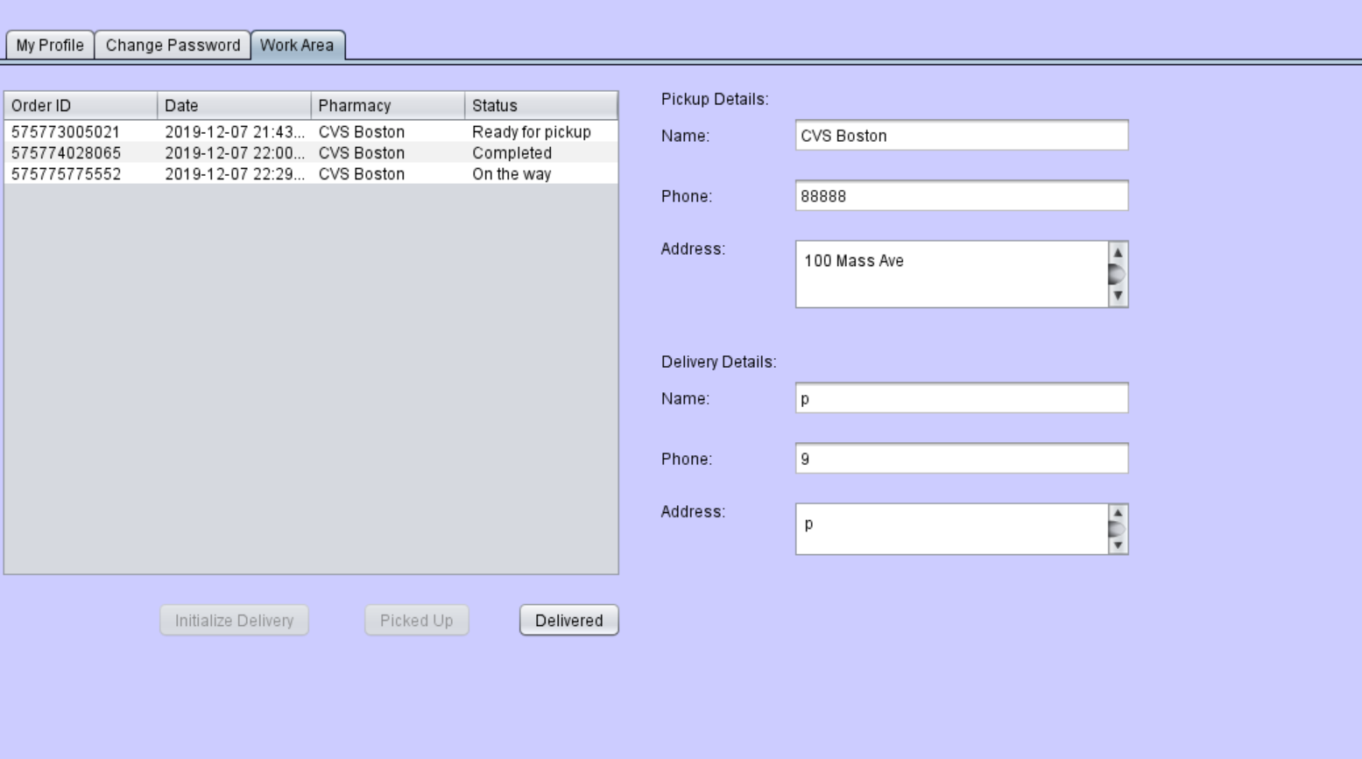
Delivery workarea –order completed

Slide 29
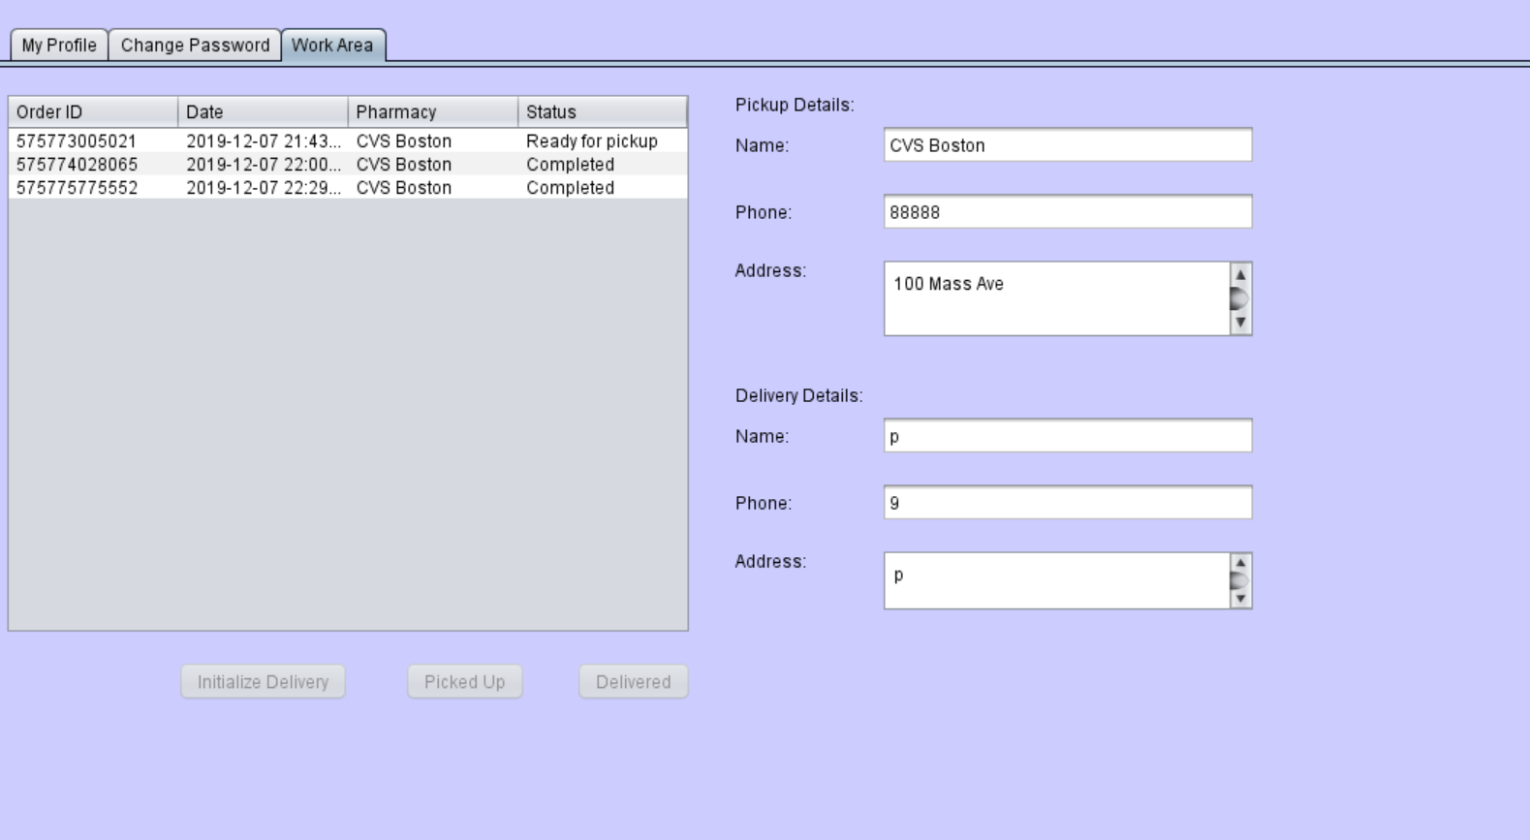
Pharmacy work area—order completed

Slide 30
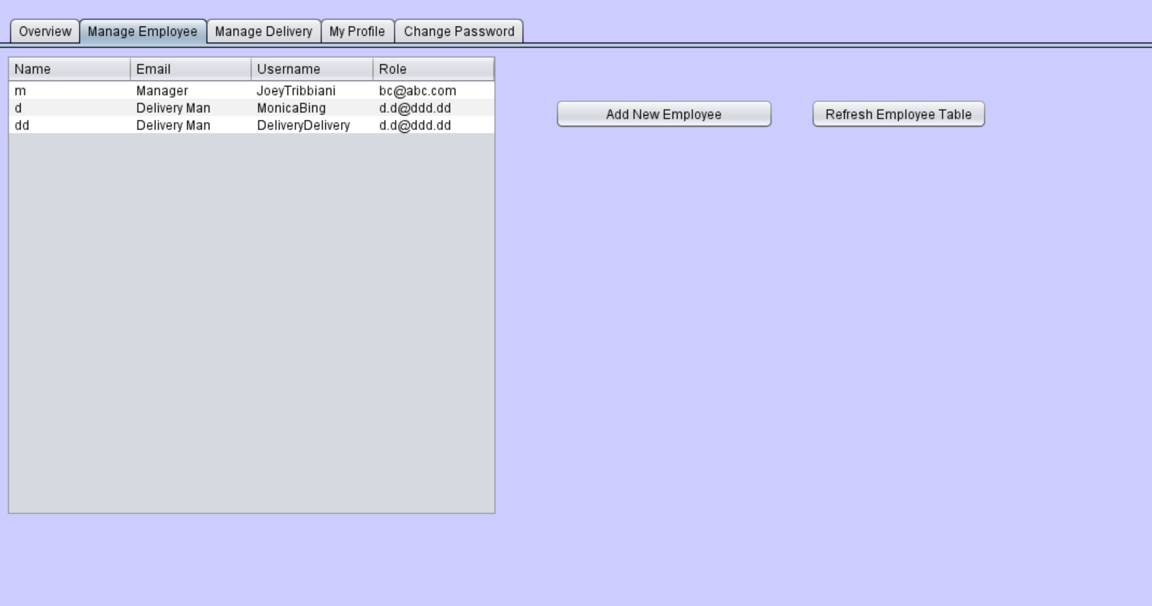
Delivery manager- manage employees

Slide 31
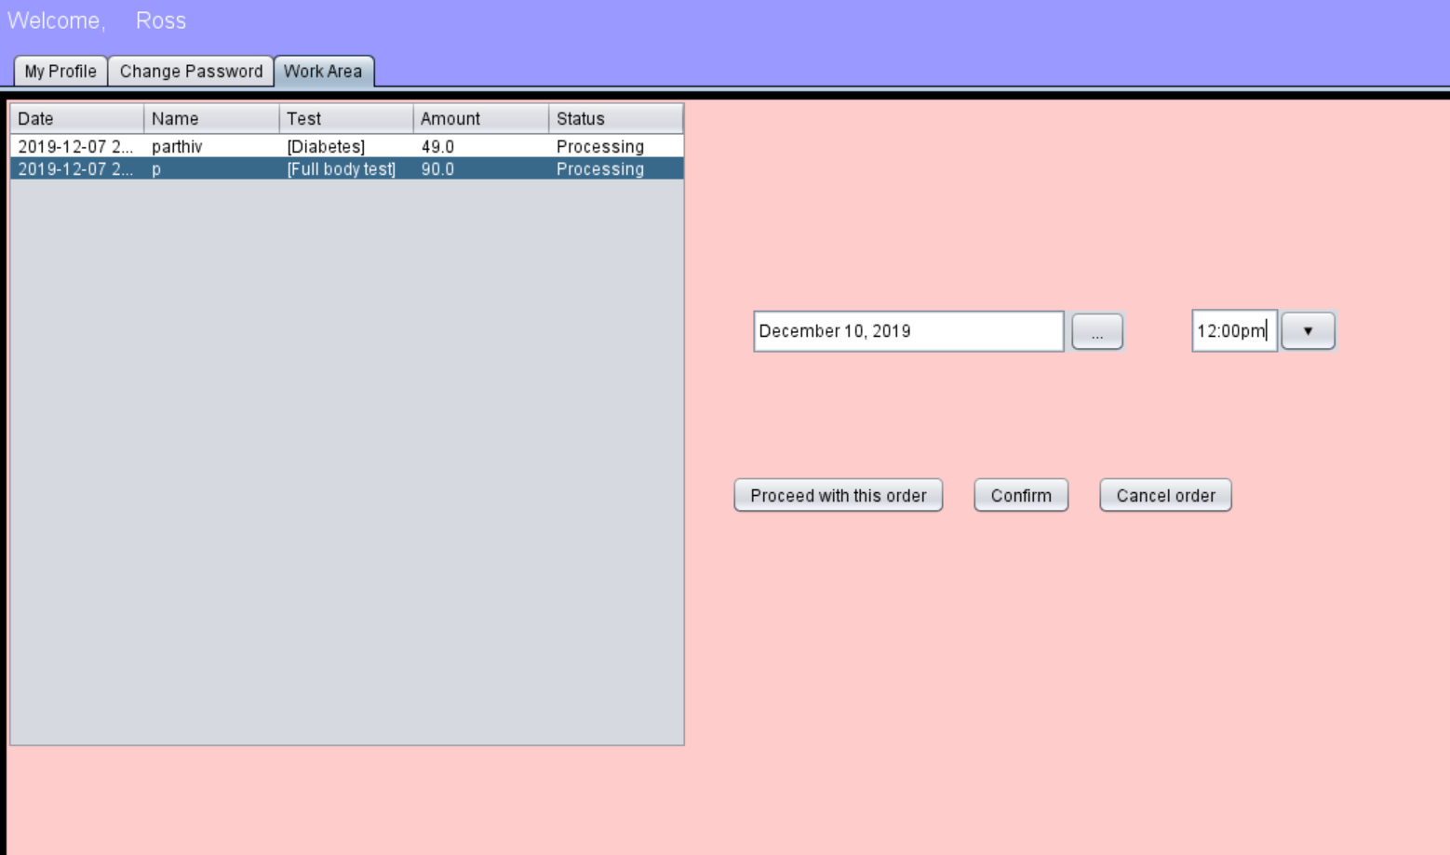
Lab work area

Slide 32
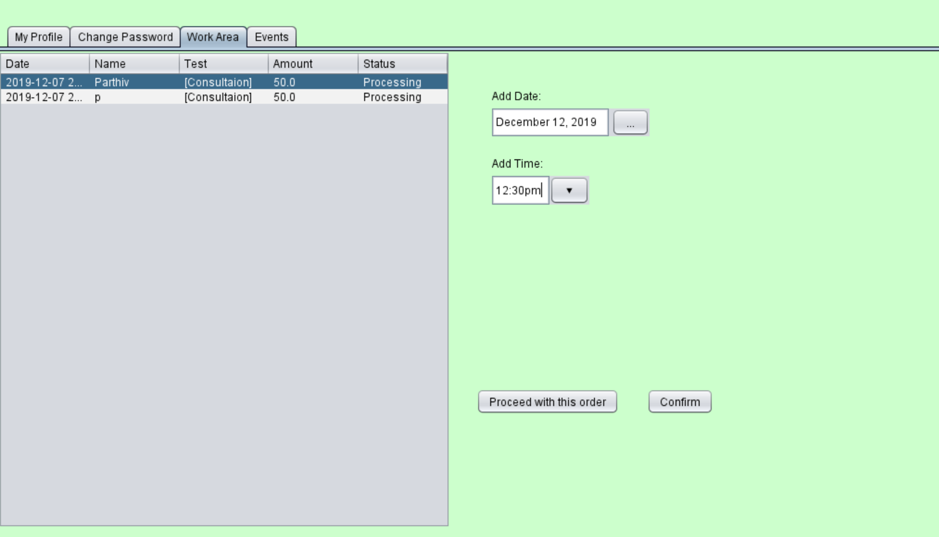
Doctor work area

